Slide 1

Regression vs Smoke Testing
Amit Dash
Nikitha Naik
Nayan Gadhari
Akshat
Abhishek Kumar

Slide 2


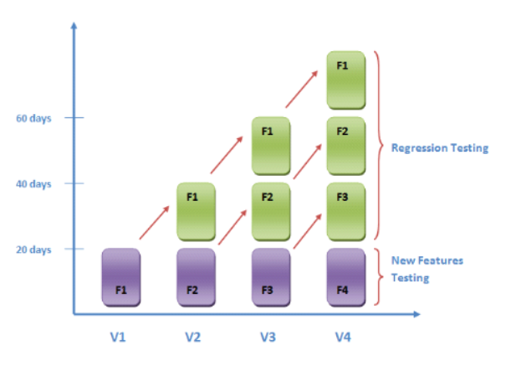
What is Regression?
REGRESSION TESTING is defined as a type of software testing to confirm that a recent program or code change has not adversely affected existing features.
Regression Testing is nothing but a full or partial selection of already executed test cases which are re-executed to ensure existing functionalities work fine.
This testing is done to make sure that new code changes should not have side effects on the existing functionalities. It ensures that the old code still works once the latest code changes are done.

Slide 3
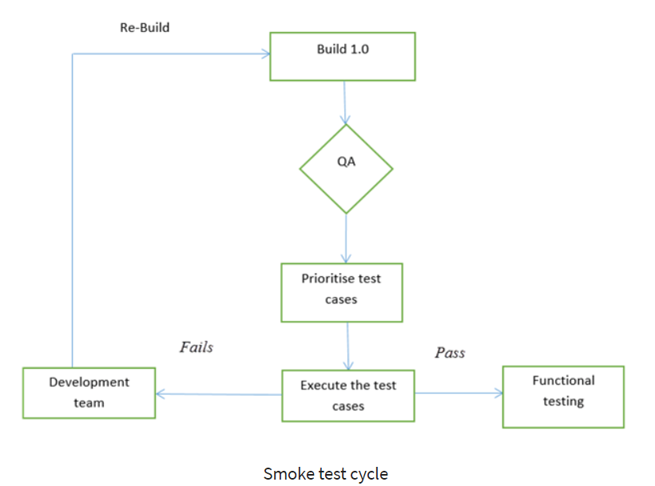
What is Smoke Testing?
Smoke Testing is a software testing process that determines whether the deployed software build is stable or not. Smoke testing is a confirmation for QA team to proceed with further software testing. It consists of a minimal set of tests run on each build to test software functionalities. Smoke testing is also known as “Build Verification Testing” or “Confidence Testing.”

Slide 4
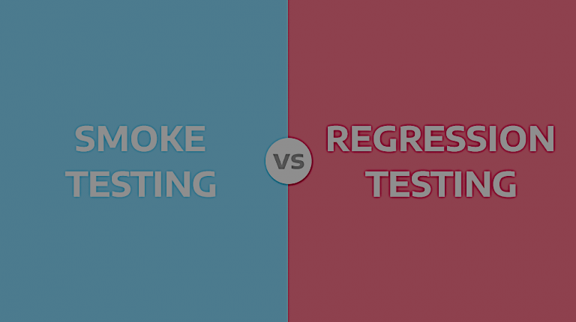
Regression vs Smoke
Smoke Testing | Regression Testing
Smoke Testing is the Surface Level Testing to verify stability of system. | Regression Testing is the Deep Level Testing to verify the rationality of system.
Smoke Test is always followed by Regression Test. | Regression Test is always carried out throughout the testing phase.
Test Cases of Smoke Test is a part of Regression Testing and covers only the core functionalities. | Regression testing is obtained from functional specification.
Smoke tests are performed by the developers. | Regression tests are performed by the professional testers.
Smoke tests are performed quickly to confirm whether to accept or reject the build. | Regression tests are not accountable for accepting or rejecting a software build for further testing procedures.
Cost of Smoke testing is low. | Cost of Regression testing is little bit high.

Slide 5
Regression Testing
With successive regression runs, test suites become fairly large. Due to time and budget constraints, the entire regression test suite cannot be executed
An effective regression strategy, save organizations both time and money. As per one of the case study in banking domain, regression saves up to 60% time in bug fixes(which would have been caught by regression tests) and 40% in money

Slide 6
Smoke Testing
In Software Engineering, Smoke testing should be performed on each and every build without fail as it helps to find defects in early stages. Smoke test activity is the final step before the software build enters the system stage. Smoke tests must be performed on each build that is turned to testing. This applies to new development and major and minor releases of the system.
Smoke tests can minimize test effort, and can improve the quality of the application. Smoke testing can be done either manually or by automation depending on the client and the organization.

